Slide 1



Project Gift Basket
Developed and Tested by Team Majesty

Slide 2


About Us
PROJECT
GIFT BASKET
Gift Basket is an Online Digital Gift Superstore in India where you can buy personalized gifts starting from T-Shirts to Cubicle Essentials for you and your loved ones from the comfort of your home.
Website: https://abhiramprints.github.io/gift_basket/
We, from Team Majesty, developed the web application, Gift Basket as per the project given to us being in HCL TECHBEE program
Gift basket

Slide 3

About Us
TEAM MAJESTY
Team Majesty is a group of HCL TECHBEE Scholars who completed the project in the form of a web application with the name Gift Basket.
The project includes real-life scenarios starting from designing the wireframe and planning till the testing and closure of the project which makes a good experience for team members, how the project will be, and its process.
Website: https://abhiramprints.github.io/gift_basket/team_majesty.html
Team Majesty –
A group of Software Enthusiasts from HCL TECHBEE
Gift basket

Slide 4

Our Team Members
Meet our Team members of Project Gift Basket
K Abhiram - Development
Tushar Prabhakar - Testing
Sharsti Arya - Testing
T Saishree - Testing
Ayush Verma - Testing
Rohit Kumar Ray
Gift basket

Slide 5






Team Members of Project Gift Basket
https://abhiramprints.github.io/gift_basket/team_majesty.html
Gift basket

Slide 6
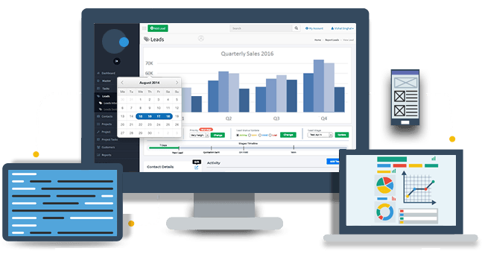
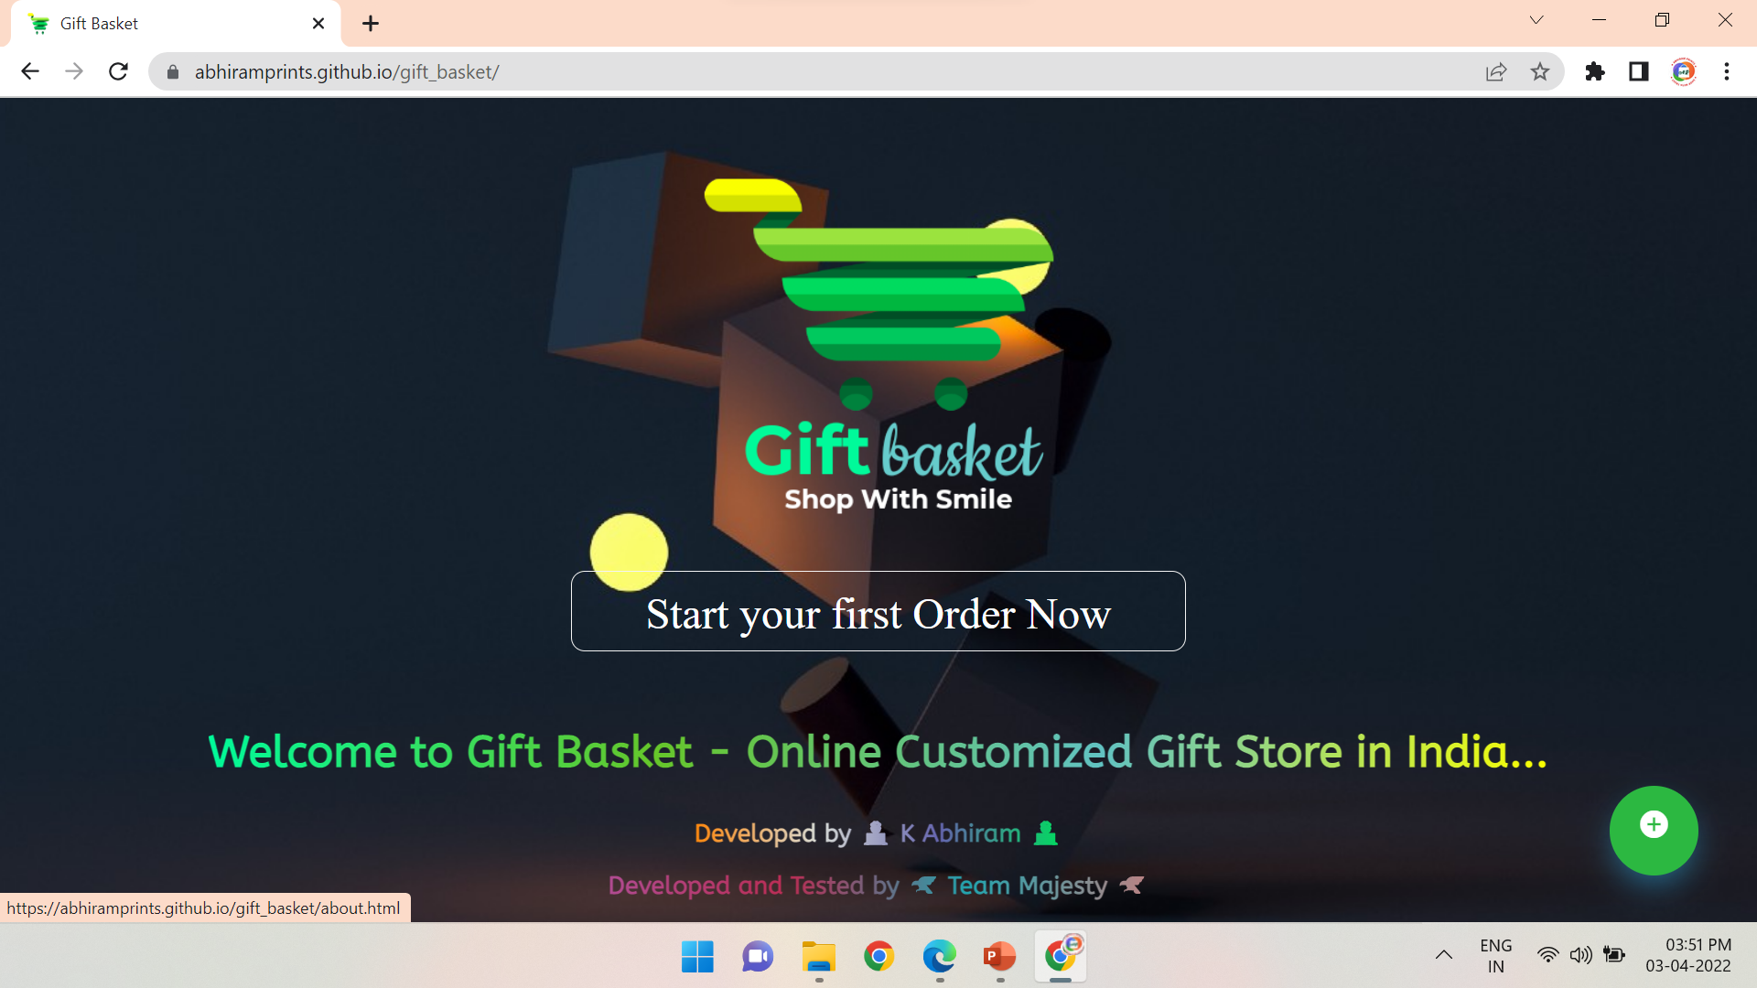
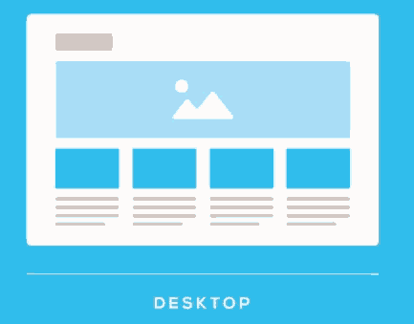
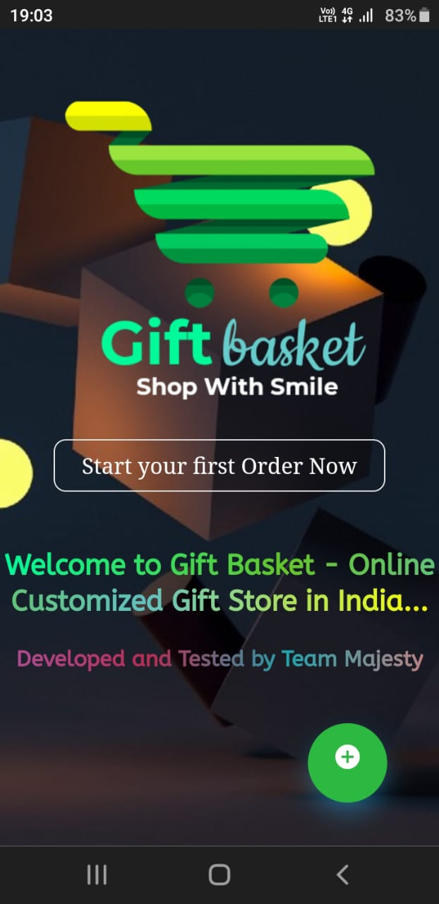
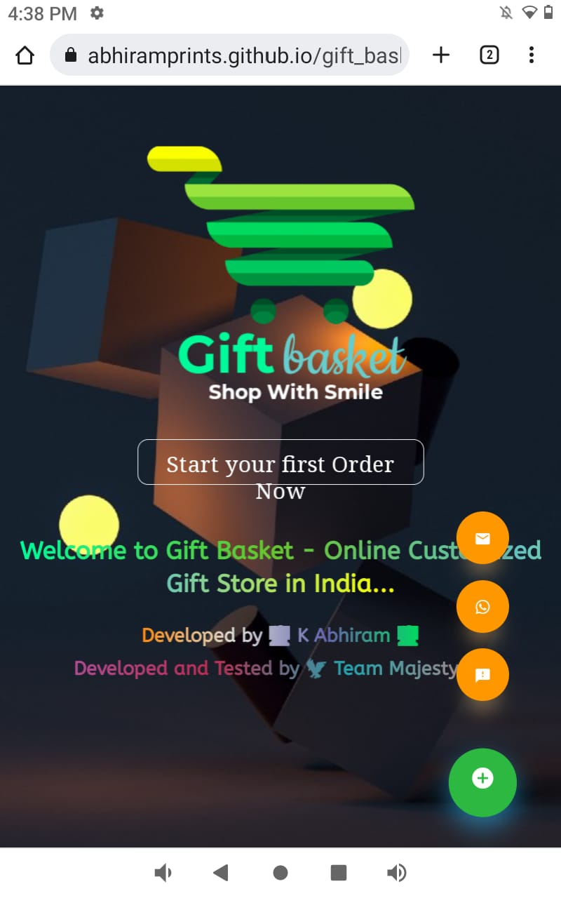


The vastness of Project Gift Basket
Gift basket

Slide 7
Project Gift Basket is easily available on all devices and gadgets
Gift basket

Slide 8

Modules in our Project
Project Gift Basket has been broadly divided into 6 modules like:
Gift basket

Slide 9
Modules in the Project Gift Basket
Single Web Page
Multiple Web Pages
Welcome Page
Home Page
Gift Basket’s Intro Page
Team Majesty’s Intro Page
Feedback Page
Footer
Product Catalogue Pages
Product Description Pages
Buy Now Pages
Transaction Pages
Gift basket

Slide 10
Welcome Page
Gift Basket’s Welcome Page contains the following elements:
1
2
4
3
https://abhiramprints.github.io/gift_basket/
Gift basket

Slide 11
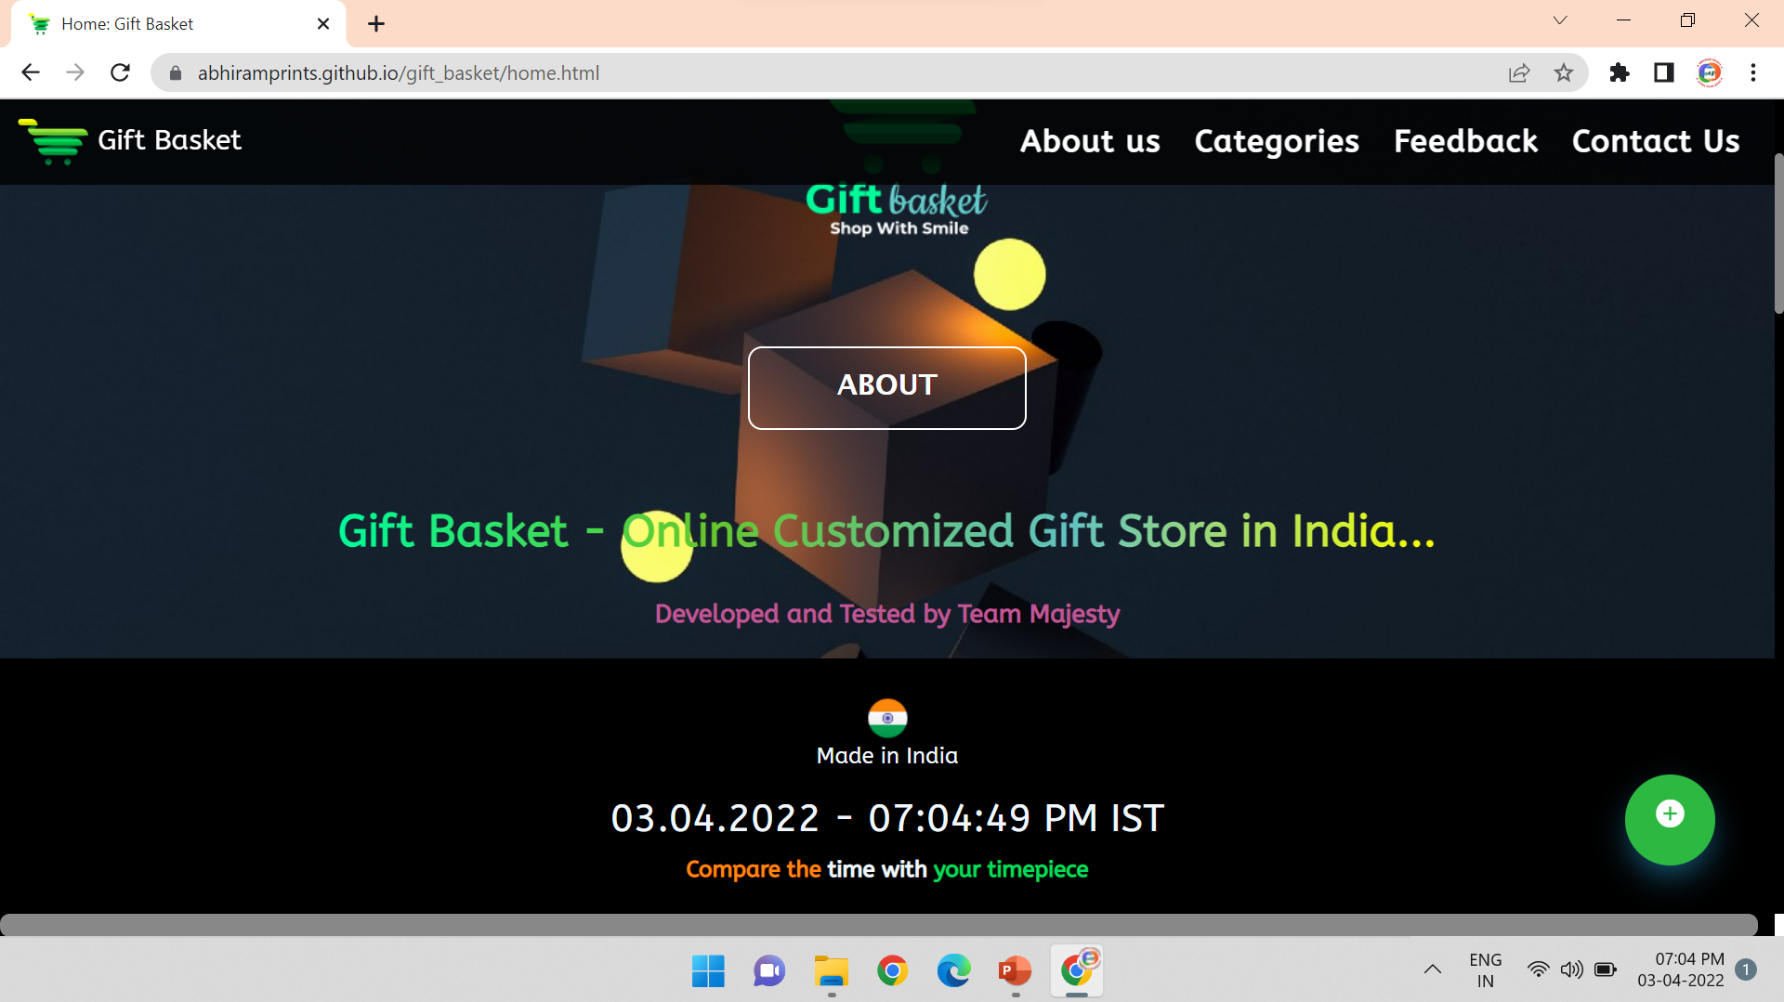
1
2
3
4
5
Home Page
6
Gift Basket’s Home Page contains the following elements:
7
8
https://abhiramprints.github.io/gift_basket/home.html
Gift basket

Slide 12
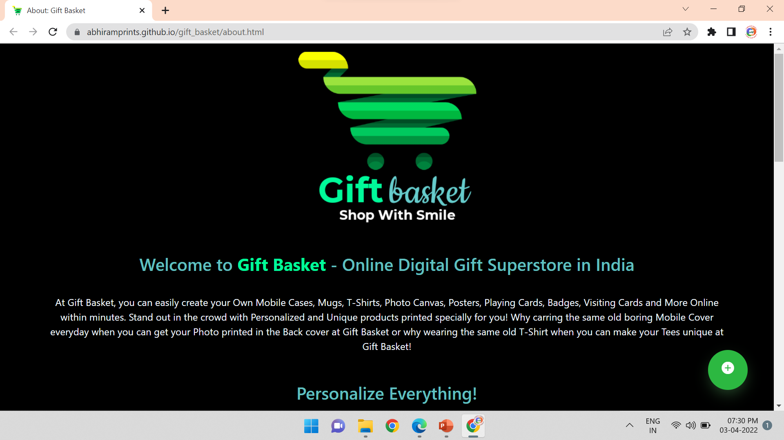
Gift Basket Intro Page
Gift Basket’s Intro Page contains the following elements:
1
https://abhiramprints.github.io/gift_basket/about.html
Gift basket

Slide 13
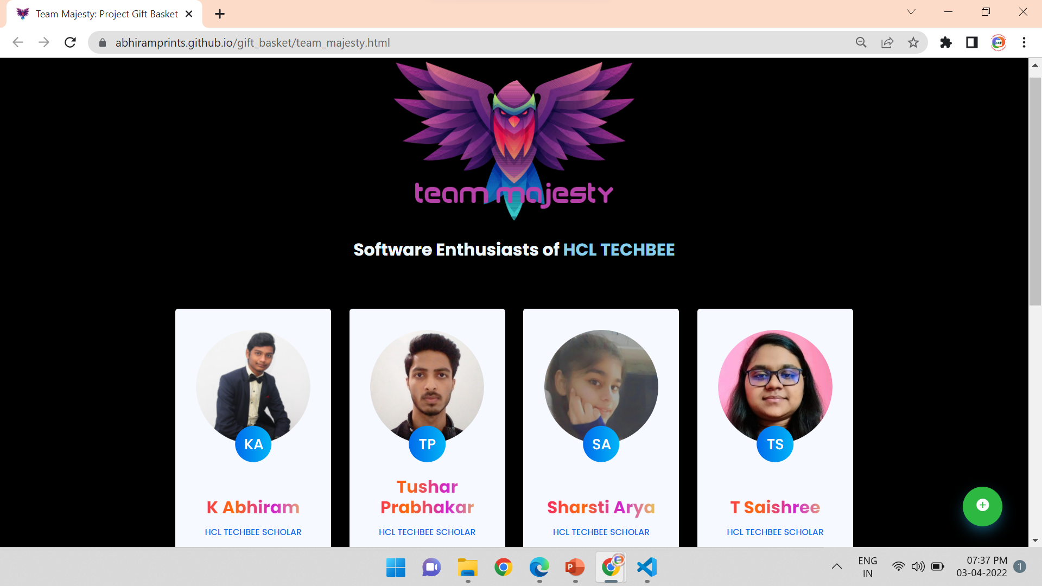
Team Majesty Intro Page
Team Majesty’s Intro Page contains the following elements:
1
2
https://abhiramprints.github.io/gift_basket/team_majesty.html
Gift basket

Slide 14
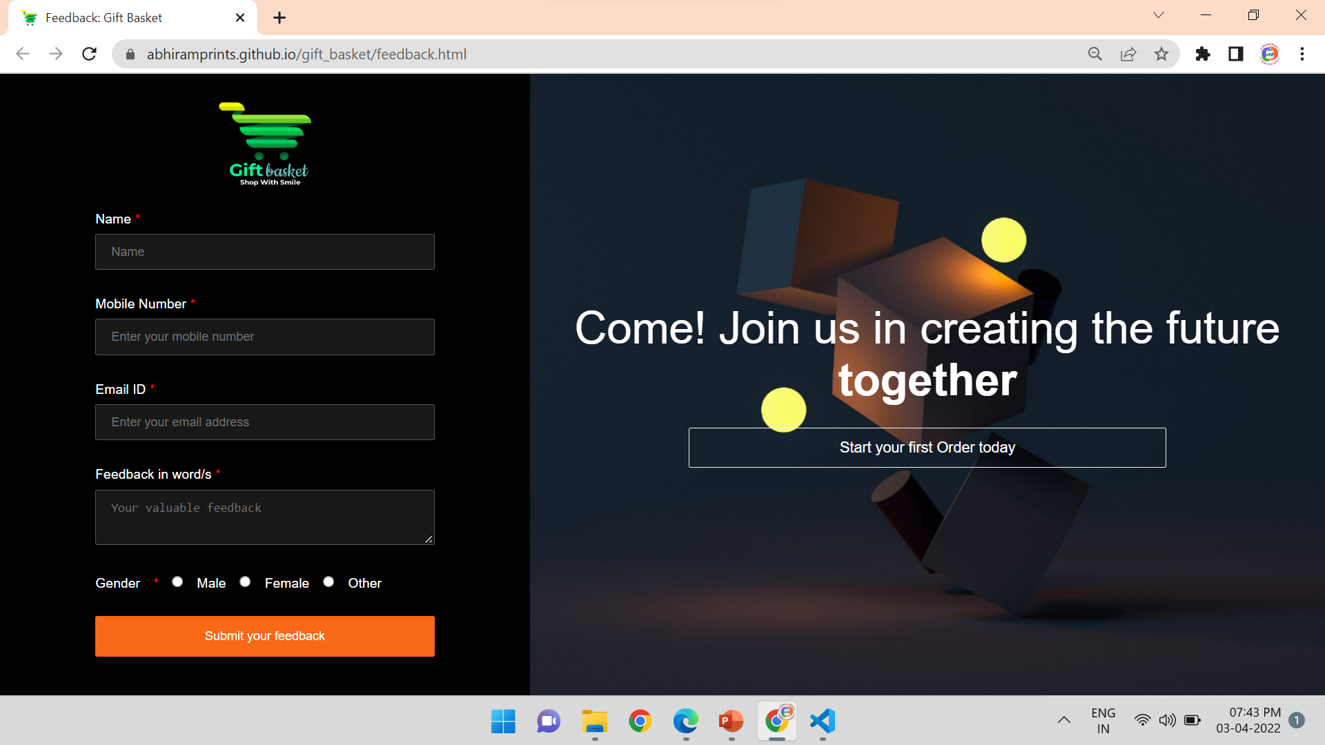
Feedback Page
Gift Basket’s Feedback Page contains the following elements:
1
https://abhiramprints.github.io/gift_basket/feedback.html
Gift basket

Slide 15
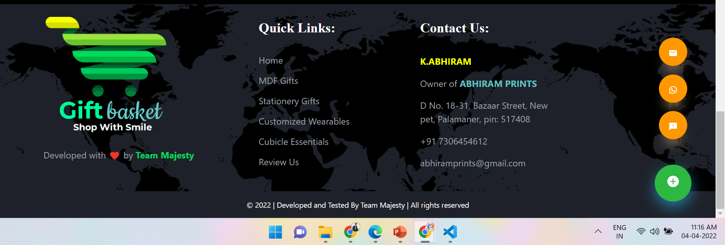
Gift Basket’s Footer
Gift Basket’s Footer contains the following elements:
Gift Basket: https://abhiramprints.github.io/gift_basket/home.html
11
3
9
6
10
12
1
4
7
13
5
8
2
14
Gift basket

Slide 16

Product Catalogue Pages
Project Gift Basket’s Product Catalogue Pages are broadly divided into 4 categories:
Gift basket

Slide 17
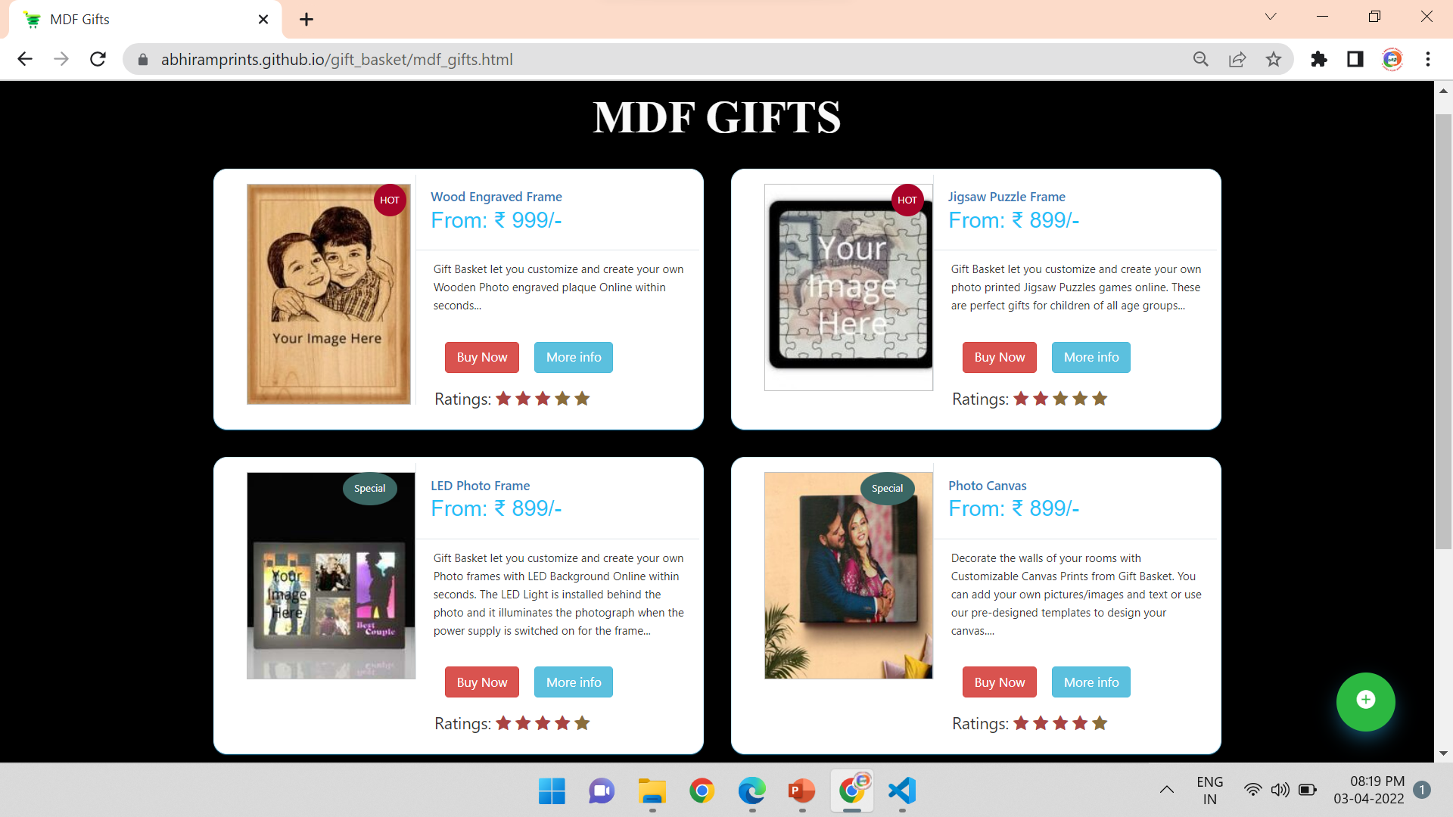
Gift Basket’s Product Catalogue Pages
3
A Gift Basket’s Product Catalogue Page contains the following elements:
1
2
4
https://abhiramprints.github.io/gift_basket/mdf_gifts.html
Gift basket

Slide 18

Product Description Pages
Project Gift Basket’s Product Description Pages are broadly divided into 16 pages:
Gift basket

Slide 19
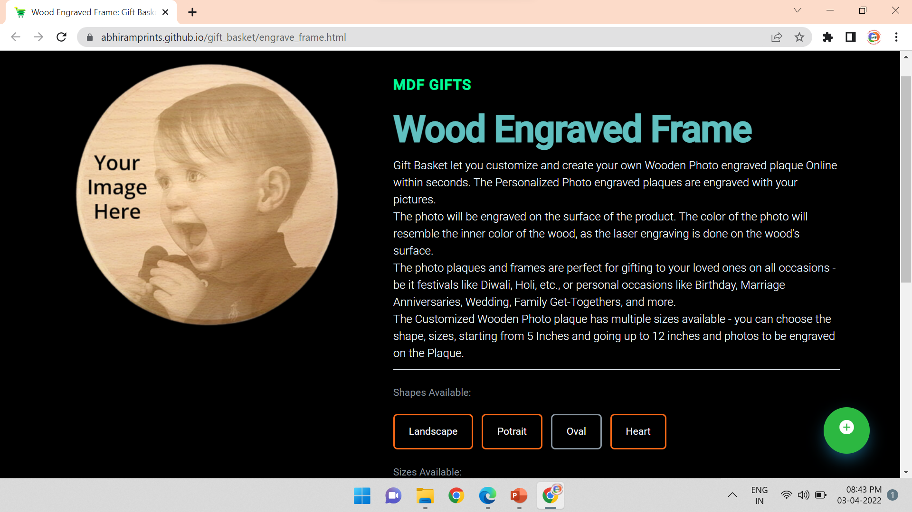
1
Gift Basket’s Product Description Pages
A Gift Basket’s Product Description Page contains the following elements:
2
https://abhiramprints.github.io/gift_basket/engrave_frame.html
Gift basket

Slide 20


Buy Now Pages
Project Gift Basket’s Buy Now Pages are broadly divided into 16 pages:
Gift basket

Slide 21
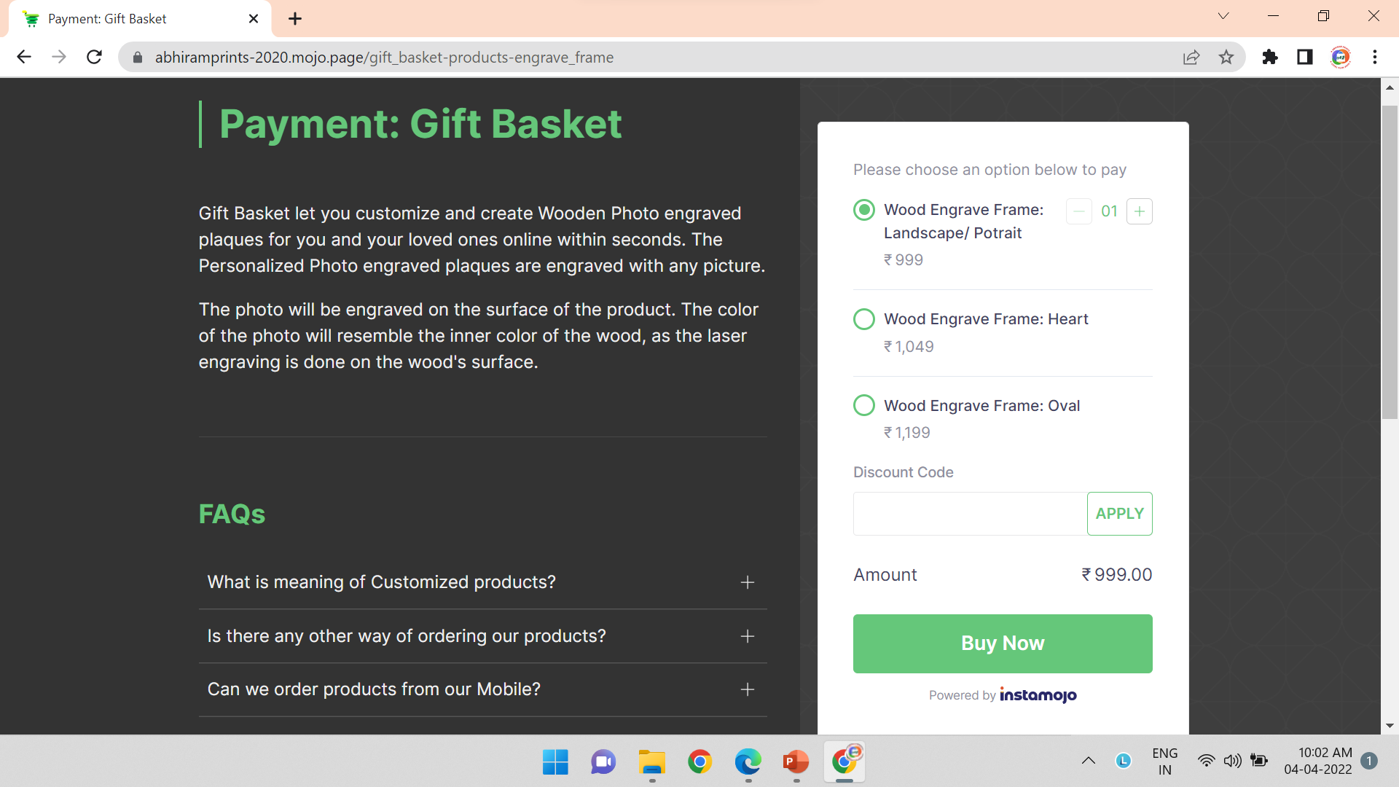
4
5
Gift Basket’s Buy Now Pages
A Gift Basket’s Product Description Page contains the following elements:
6
7
1
2
8
3
https://abhiramprints-2020.mojo.page/gift_basket-products-engrave_frame
Gift basket

Slide 22
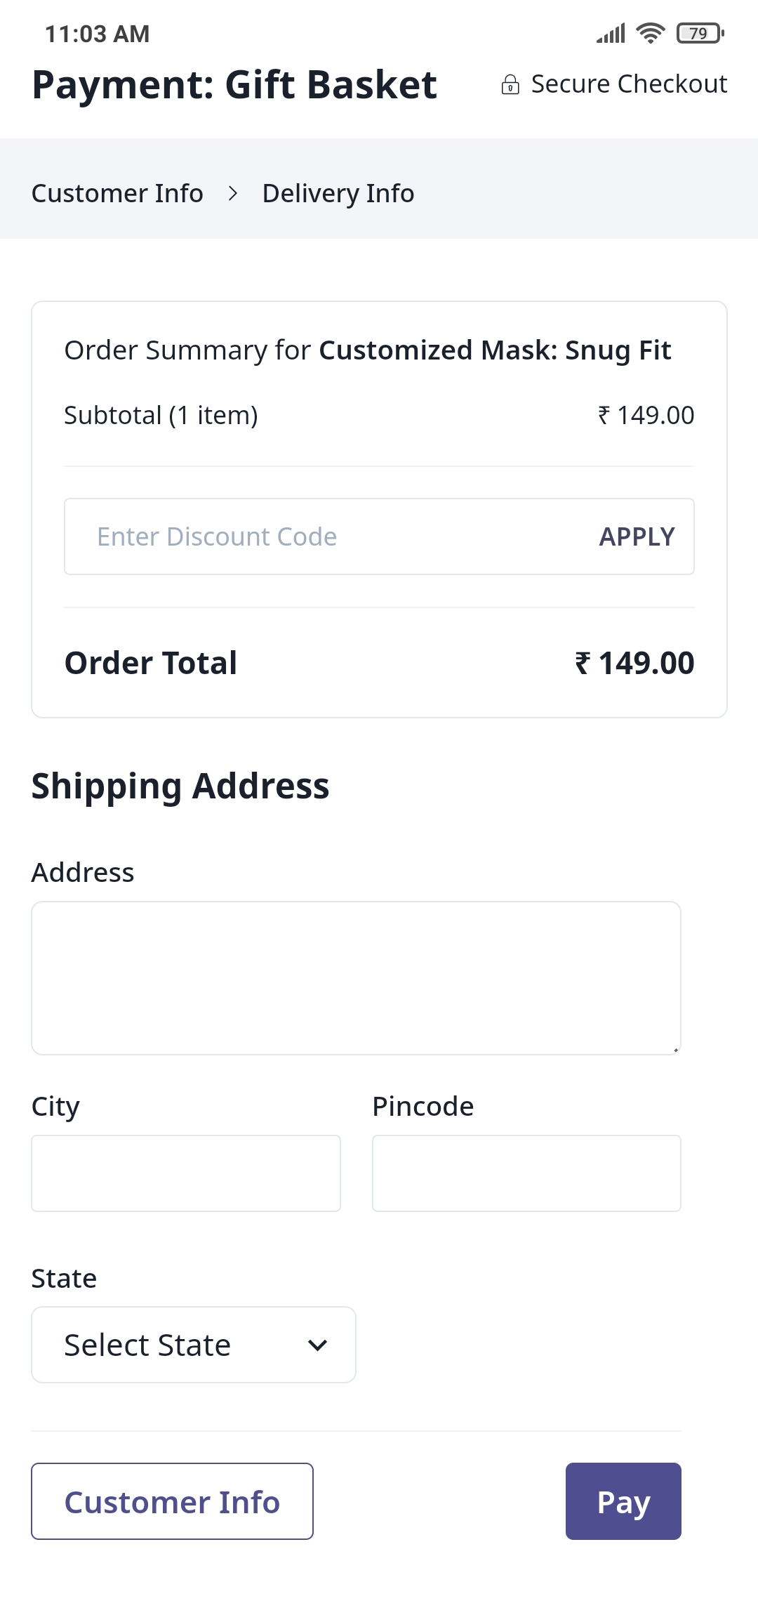
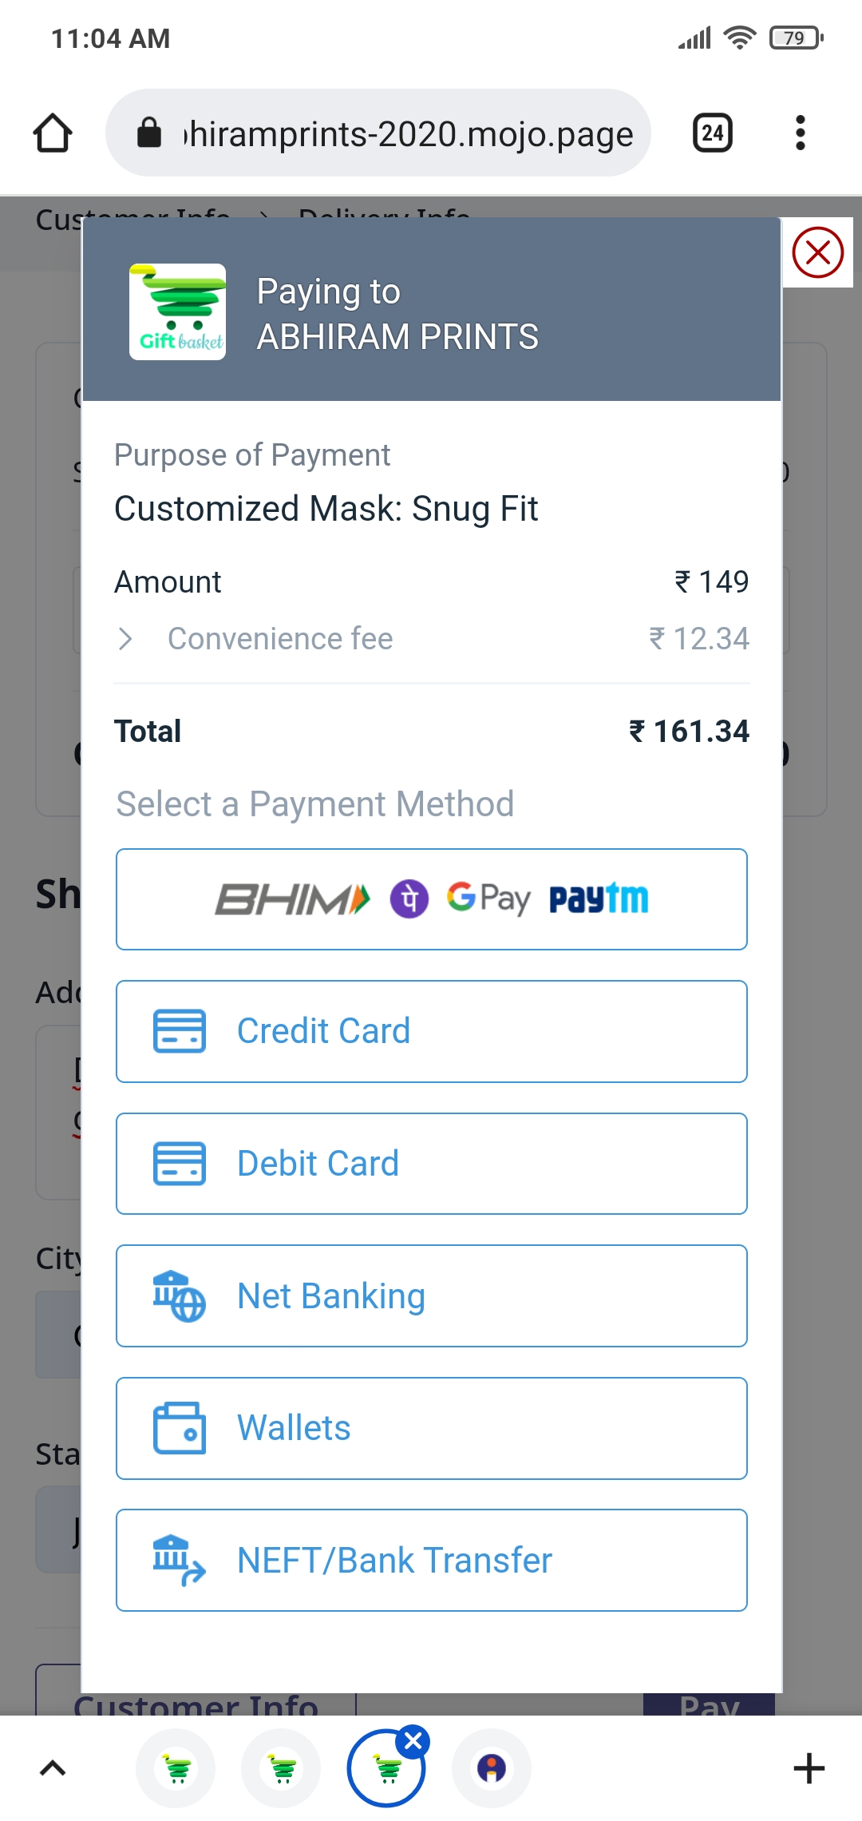
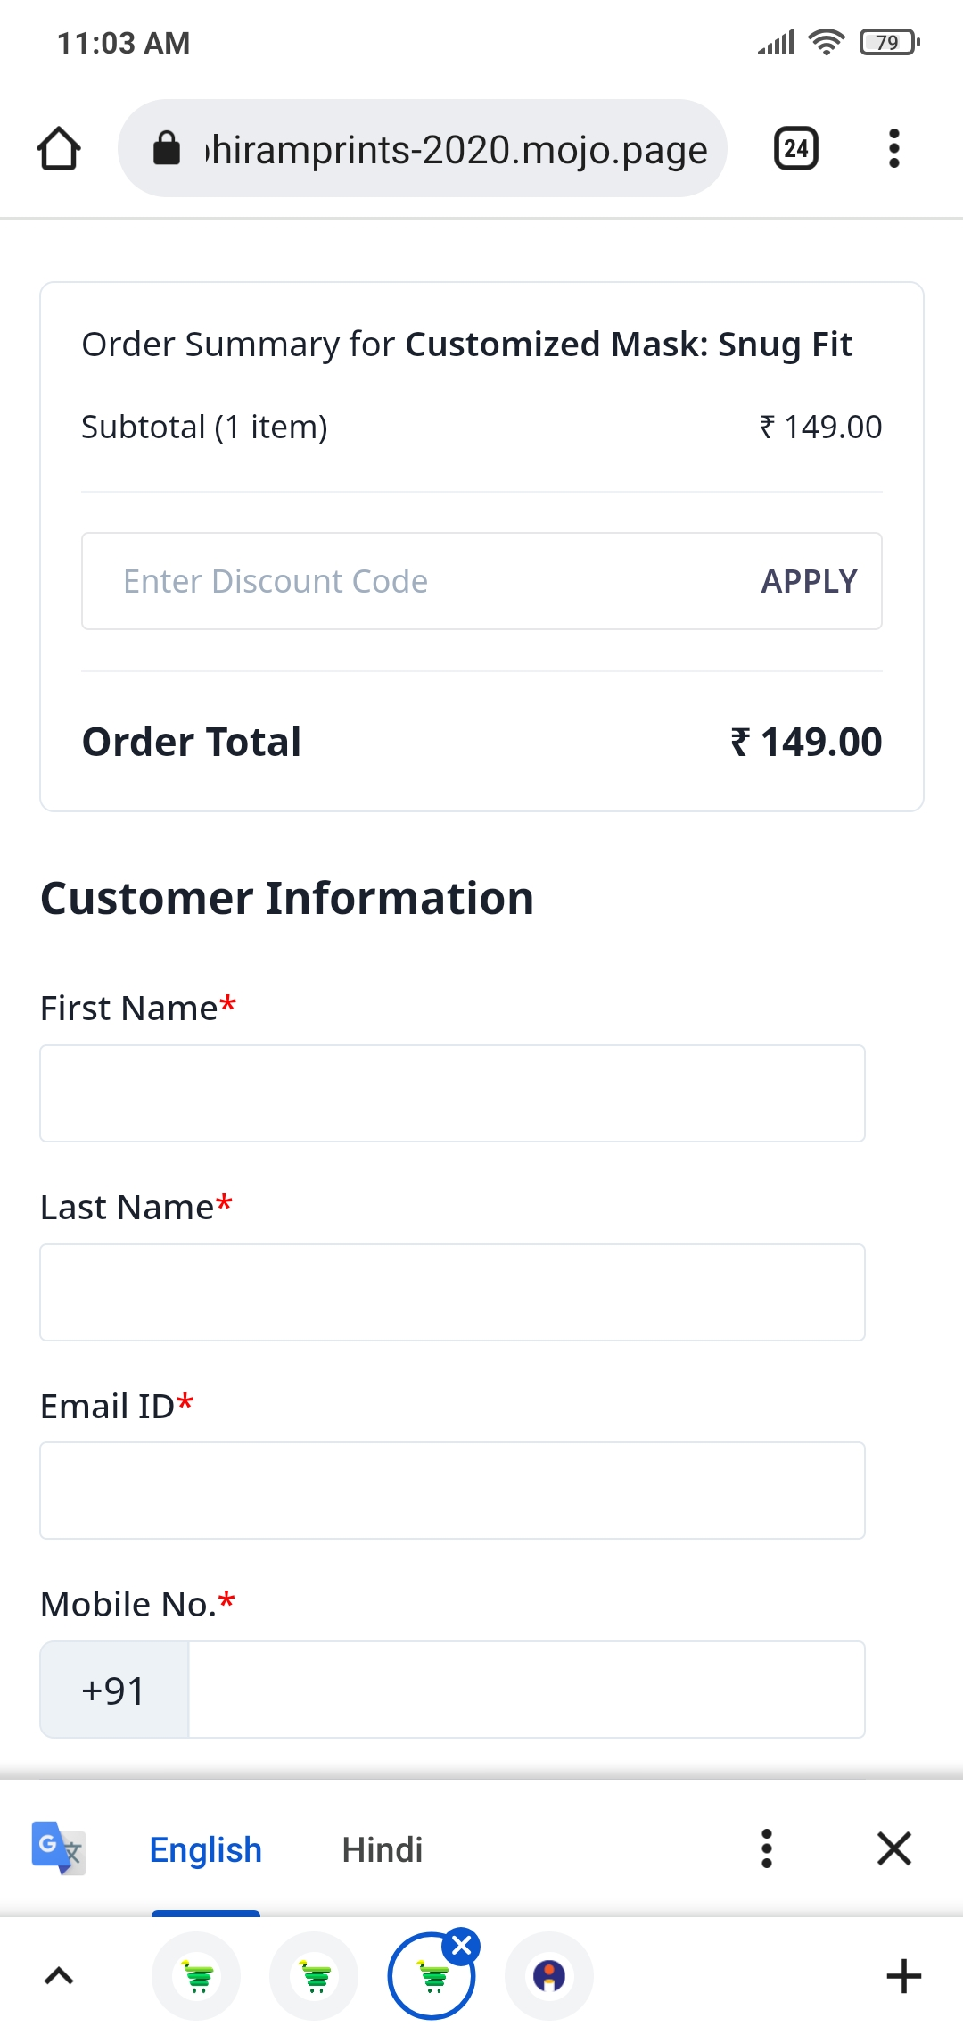
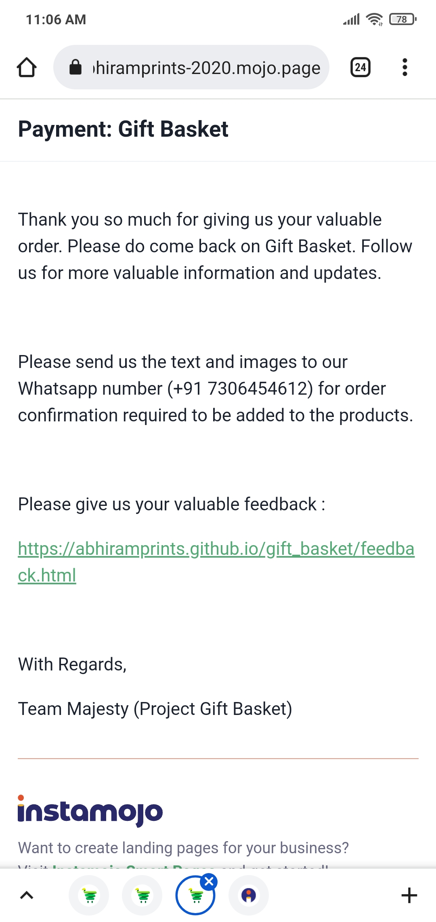
Way to complete the Transaction and order the product from Gift Basket
Gift basket

Slide 23
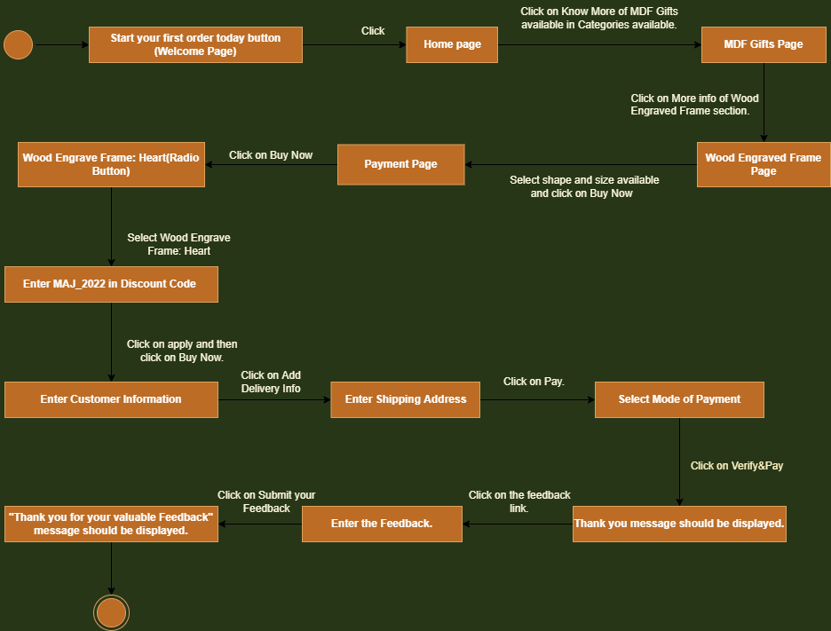
State Transition Diagram of Project Gift Basket:
Gift basket

Slide 24
Overview of Project Gift Basket’s Product Catalogue
The below table shows the overview of all products that are mentioned in the Project Gift Basket
Categories and its Products | MDF GIFTS | STATIONERY GIFTS | CUSTOMIZED WEARABLES | CUBICLE ESSENTIALS
1 | Wood Engraved Frame | Letter Heads | T Shirts | Personalized Pen Stand
2 | Jigsaw Puzzle Frame | Notepad | Customized Hoodie | Personalized Sipper
3 | LED Photo Frame | Customized Diaries | Personalized Cap | Smart Tiffin Box
4 | Photo Canvas | Personalized Holders | Customized Mask | Personalized Smart Belt
Gift basket

Slide 25





Thank You
Team Majesty
+91 7306454612
abhiramprints@gmail.com
Gift Basket
Done By K Abhiram
Gift basket

